Slide 1
Popular Video Games Data Analysis
Group 1 Karen Chen, Brian Chien,
Qinyi Zhong

Slide 2
TABLE OF CONTENTS
01
02
03
INTRODUCTION
DATA ANALYSIS
CONCLUSION

Slide 3
01
Popular Video Games 1980-2023
INTRODUCTION
Notes:
Q

Slide 4
Popular Video Games
Data Background & Source
Data Structure & Content
Data Collection & Solidity
Data Usability & Interest
Notes:
Q

Slide 5


DATA BACKGROUND & SOURCE
Kaggle.com
Backloggd.com
The World’s Largest Data Science Community
A Video Game Collection Tracker
Notes:
Q

Slide 6
Structure & Content
Title = title of the game
Release date = date of release of the game’s first version
Team = game developer team
Rating = average rating
Times listed = number of users who listed this game
Number of reviews = number of reviews received from the users
Genres = all genres pertaining to a specified game
Summary = summary provided by the team
Reviews = user reviews
Plays = number of users that have played the game before
Playing = number of current users who are playing the game
Backlogs = number of users who have access but haven’t started with the game yet
Wishlist = number of users who wish to play the game
Notes:
B

Slide 7
Collection & Solidity
Usability & Interest
Our Interest
Game Players
Game Developers / Publishers
Data Collection Method
Solidity / Reliability
Notes:
Q

Slide 8
02
DATASET ANALYSIS
Notes:
B

Slide 9
ANALYSIS PROCESS
NORMALIZATION
VISUALIZATIONS
ERD
QUERIES
Visualized Relationship
Data Exploration
Data Organization
Queries Presentation
Notes:
B

Slide 10
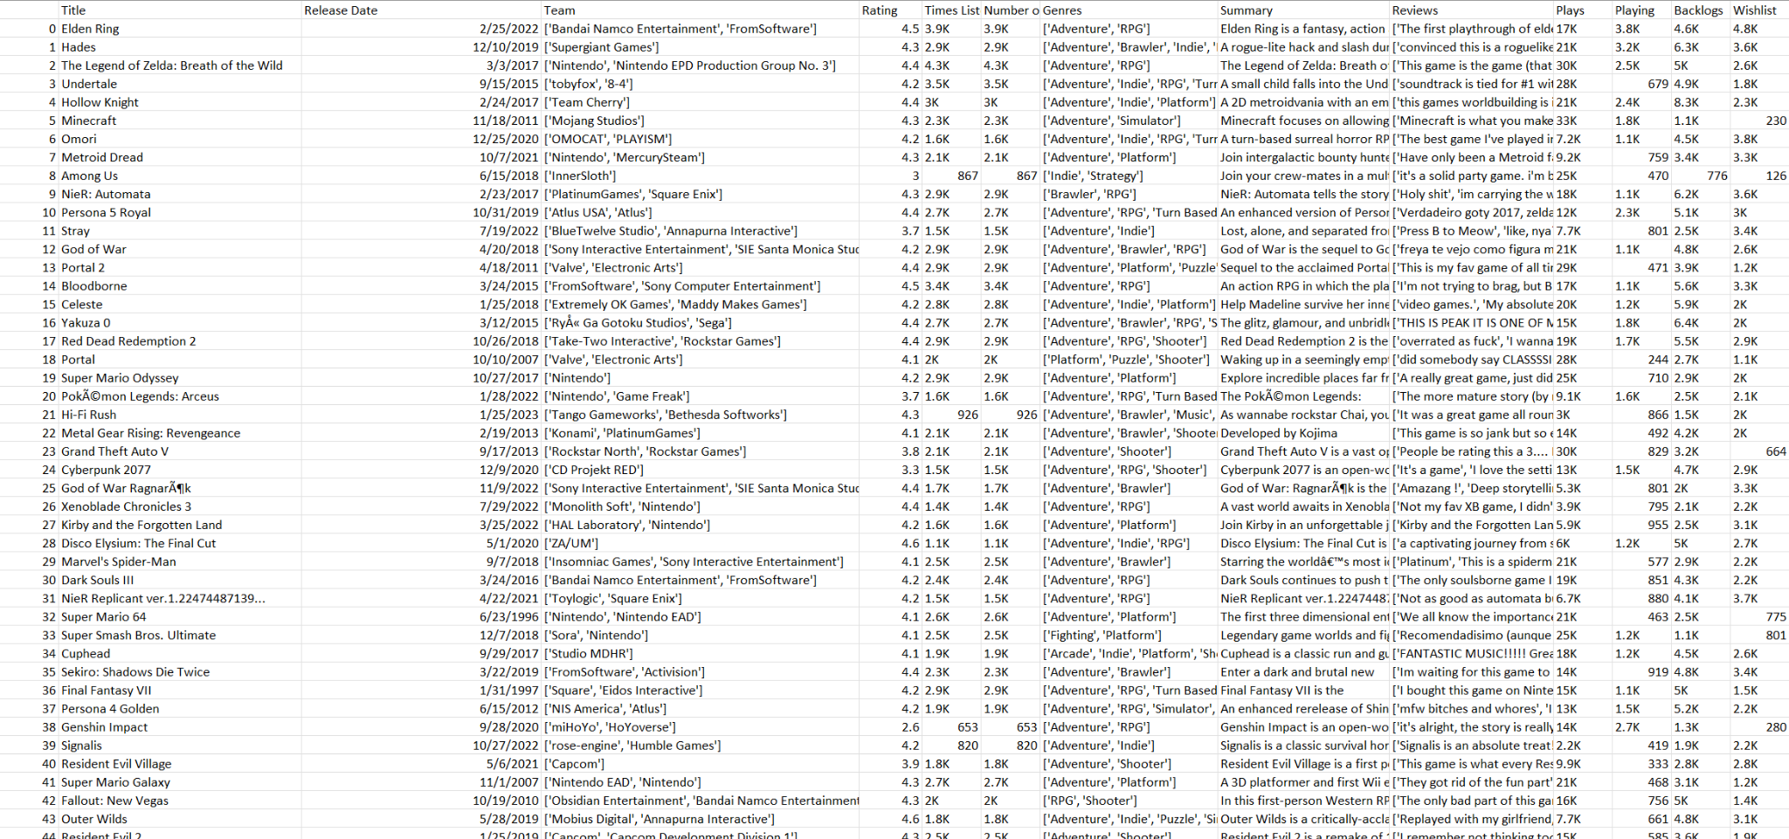
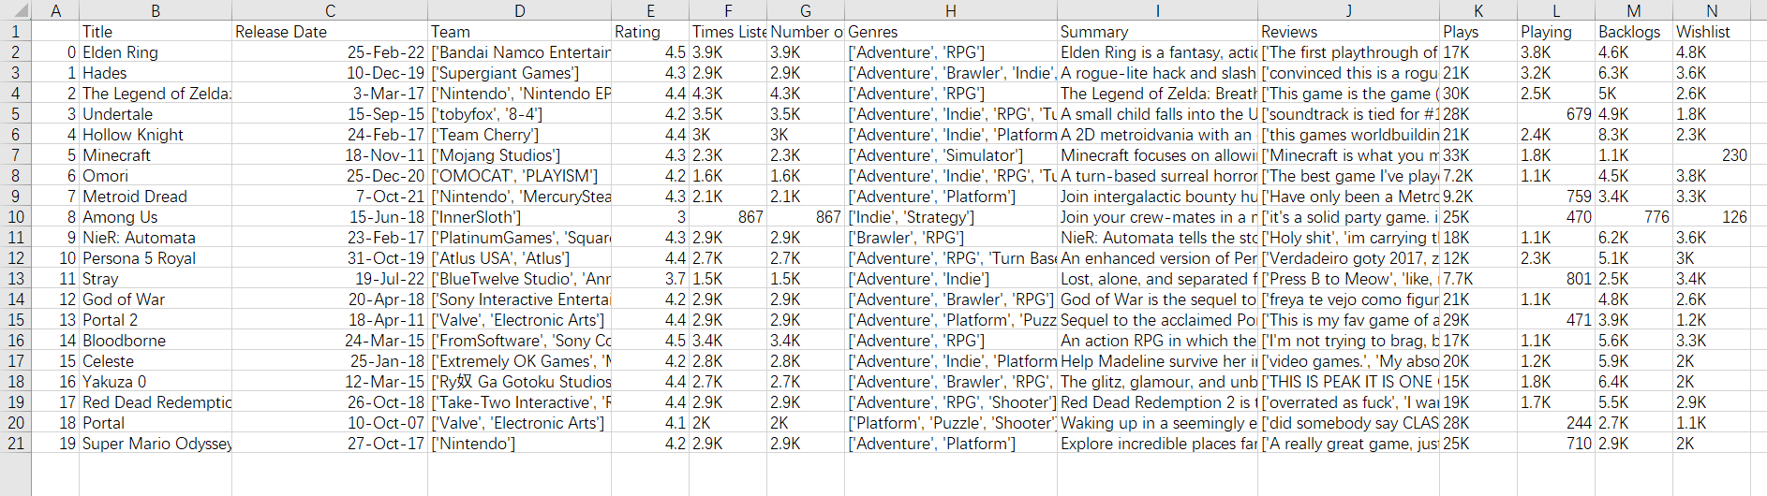
CSV File
Notes:
B : Splitting the team, genre, and reviews column

Slide 11
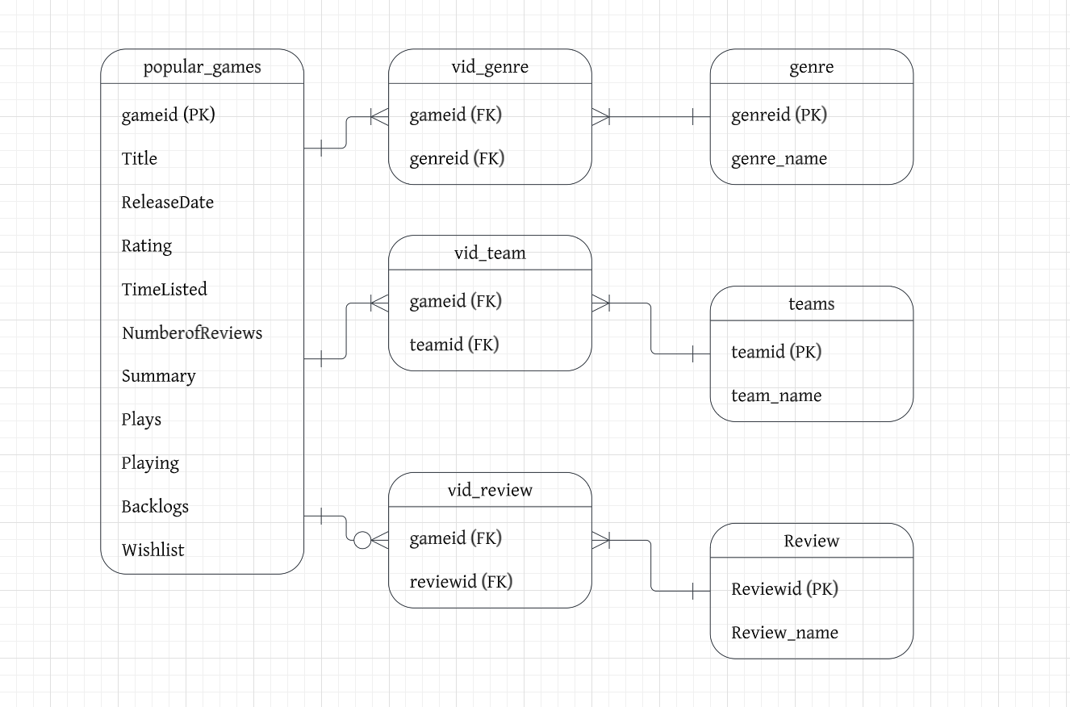
ERD
Notes:
K

Slide 12
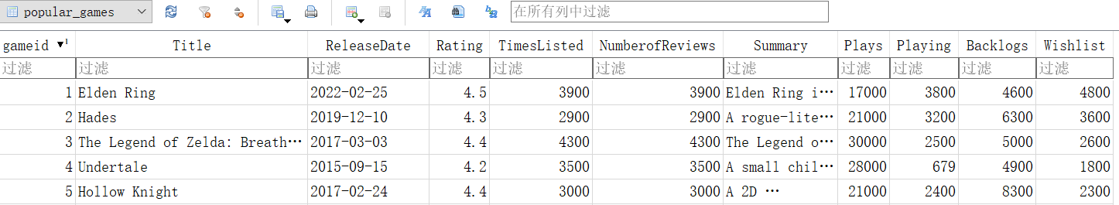
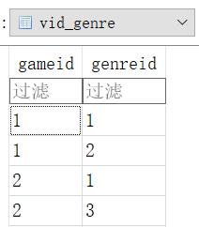
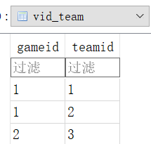
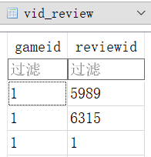
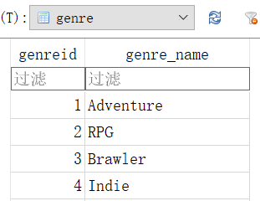
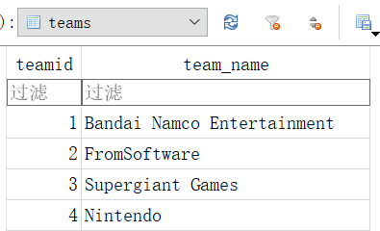
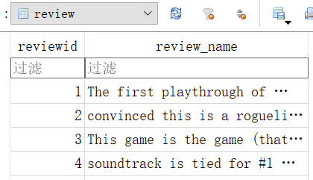
Normalization
Notes:
K

Slide 13
QUERY
What are the most played video games of each year from 2013 to 2023?
​​SELECT strftime('%Y', ReleaseDate) AS Year, Title, MAX(Plays) AS Plays
FROM popular_games
WHERE ReleaseDate BETWEEN '2013-01-01' AND '2023-12-31'
GROUP BY Year
ORDER BY Year DESC;
Notes:
K

Slide 14

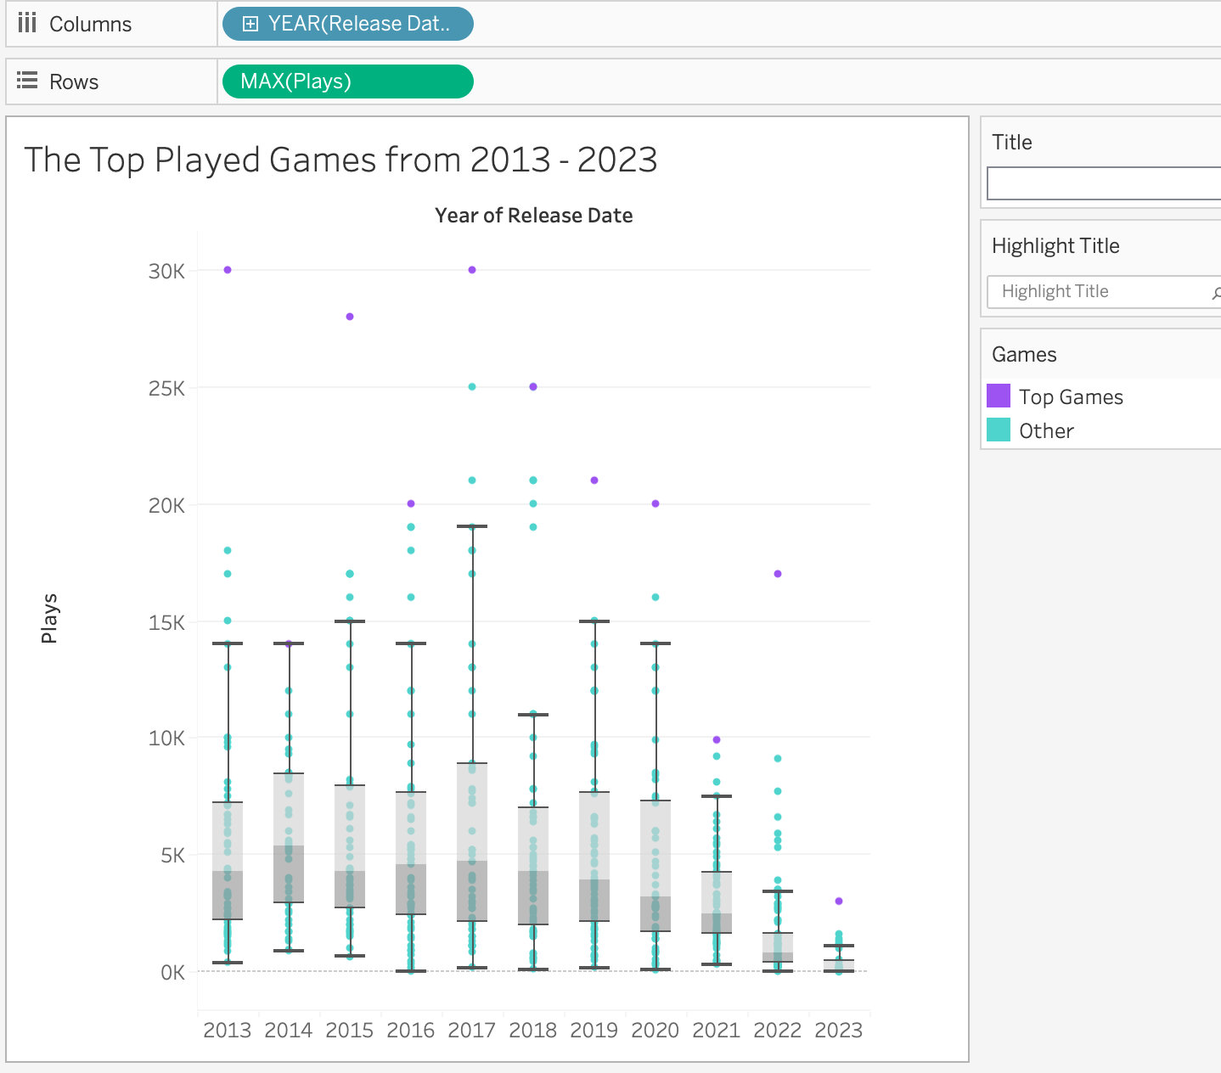
Visualization
Purple group: Top played games
Green group : other games
The number of plays ranges from 3K to 30K
Notes:
K

Slide 15
QUERY
Which developer has the highest average rating for their games?
SELECT teams.teamid, teams.team_name, AVG(popular_games.Rating) AS avg_rating
FROM teams
JOIN vid_team ON teams.teamid = vid_team.teamid
JOIN popular_games ON vid_team.gameid = popular_games.gameid
GROUP BY teams.teamid, teams.team_name
ORDER BY avg_rating DESC
LIMIT 1;
Notes:
K

Slide 16
QUERY
What is the average number of players currently playing for each genre?
SELECT g.genre_name, AVG(pg.Playing) as Average_Playing
FROM popular_games AS pg
JOIN vid_genre AS vg ON pg.gameid = vg.gameid
JOIN genre AS g ON vg.genreid = g.genreid
GROUP BY g.genre_name
ORDER BY Average_Playing DESC;
Notes:
Q

Slide 17
QUERY
What is the average number of players in backlog for each genre?
SELECT g.genre_name, AVG(pg.backlogs) AS Average_Backlogs
FROM popular_games AS pg
JOIN vid_genre AS vg ON pg.gameid = vg.gameid
JOIN genre AS g ON vg.genreid = g.genreid
GROUP BY g.genre_name
ORDER BY Average_Backlogs DESC;
Notes:
Q

Slide 18
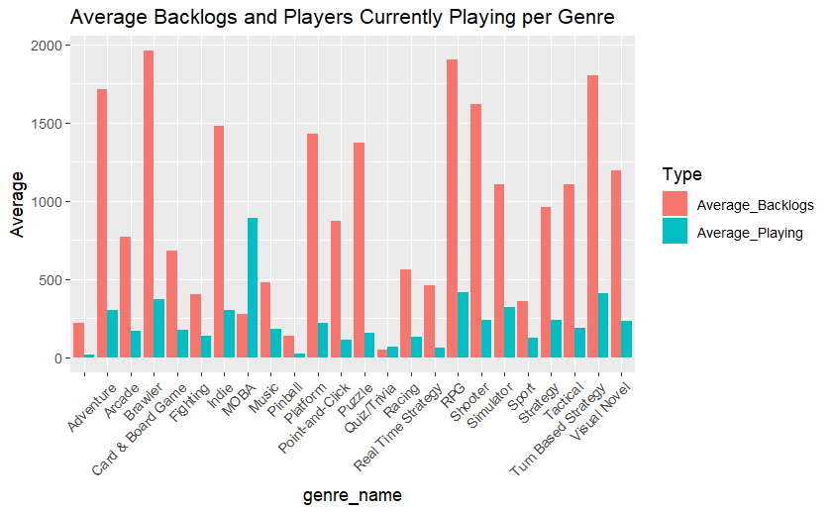
Visualization
High avg. backlog + low avg. playing = interested but play less
Low avg. backlog + high avg. playing = many active players
Notes:
Q

Slide 19
QUERY
Which 6 genre has the highest average amount of reviews?
SELECT g.genre_name, AVG(NumberofReviews) AS avg_review
FROM genre as g, vid_genre as vg, popular_games as p
WHERE g.genreid = vg.genreid AND p.gameid = vg.gameid
GROUP BY g.genreid
ORDER BY avg_review DESC
LIMIT 6;
Notes:
B

Slide 20
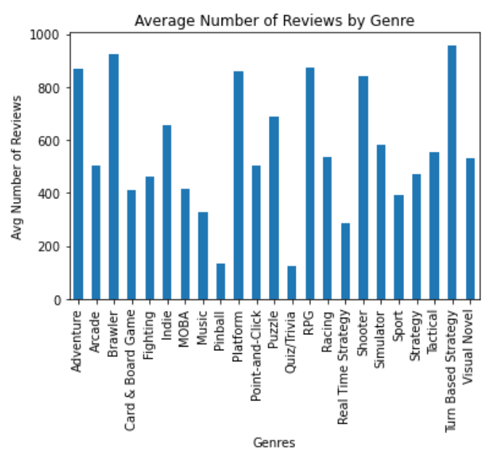
Visualization
Turn Based Strategy > Brawler > RPG >Adventure > Platform > Shooter
Notes:
B

Slide 21
QUERY
What is the best-selling adventure game each year?
SELECT strftime(‘%Y’, p.ReleaseDate) AS Year, p.Title, MAX(p.Plays + p.Playing +
p.Backlog) AS total_sales
FROM popular_games AS p, genre AS g, vid_genre AS vg
WHERE p.gameid = vg.gameid AND vg.genreid = g.genreid AND
g.genre_name = ‘Adventure’ AND Year >0
GROUP BY Year
ORDER BY Year DESC;
Notes:
B

Slide 22
CONCLUSION
03
Notes:
B

Slide 23
Conclusion
There’s a fluctuation in game plays from 2013 - 2017, but the number of users who played the games decrease overtime → gaming industry changes or possibly decline?
Genres that have exceptionally high interests and expectation are Card & Board game, RPG, and Turn Based Strategy
Action games, along with the features of role-playing and mission solving tend to be more sensational or more likely to be discussed
Notes:
B

Slide 24
Thank You

Slide 25
RESOURCES
PHOTOS
https://upload.wikimedia.org/wikipedia/commons/7/7c/Kaggle_logo.png?20140912155123
https://www.slidesgo.com/
https://pbs.twimg.com/profile_images/1541908760607821824/3Am5dmsx_400x400.jpg Close-up confident adult woman posing

